Slide 1
Job Portal
Presented by : anish Richcha & Komal Rochlani

Slide 2
Introduction
This system site allocates the right job information for suitable persons.
All the jobseekers as well as job providers’ information are stored in the database.
This Portal will primarily focus on the posting and management of job vacancies.
This system is designed such that ultimately all vacancies will be posted online and would offer employers the facilities to post their vacancies online.
The job Portal System that is to be developed provides the members with jobs information, online applying for jobs and many other facilities.

Slide 3
Functionalities
Job Provider can post job
Job Provider can see the applied job seeker list
Job Seeker can apply for the job
Job Seeker can see the list of applied jobs
Forgot Password
Registration

Slide 4
Job Provider Module
Upload new jobs for the in various fields. Apart from this,
The job provider can edit his/her profile ,
Can Delete their account
Check the applicant who has applied For different jobs
Shortlist them by sending the message .

Slide 5
Job Seeker Module
After successful registration ,the job seeker can
Can edit his/her profile ,
Delete account and
Check the response of any job he/she has applied for earlier in
status option.

Slide 6
Admin Functionalities
Can see the Job Provider List
Can see the Job Seeker List
Can delete both job provider and job seeker

Slide 7
Requirements
Hardware Requirements
RAM: 1 GB (further increase that as per requirement.)
Hard Disk: 80 GB (further increase that as per requirement.)
Display: 1024 * 768, True Type Color-32 Bit
Mouse: Any Normal Mouse.
Keyboard: Any window Supported Keyboard.
2. Software Requirements
Database Server : MySQL Server
Web Server : Internet Information Server
Technologies : React js, CSS, SPRING BOOT

Slide 8
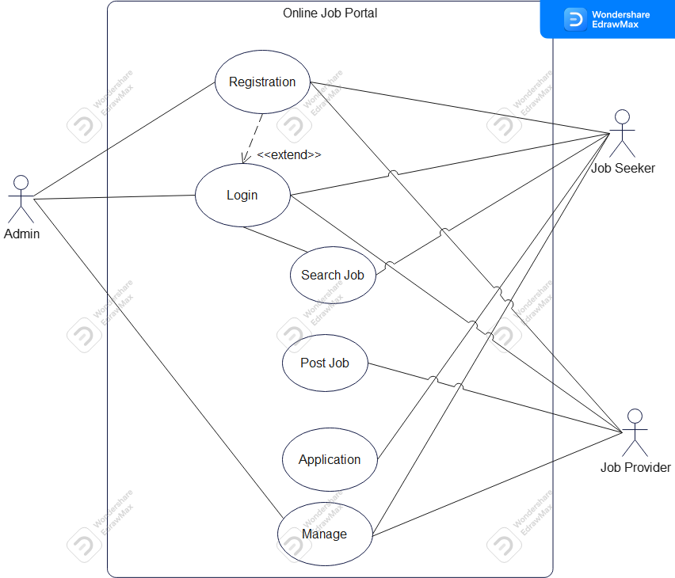
Use Case Diagram

Slide 9
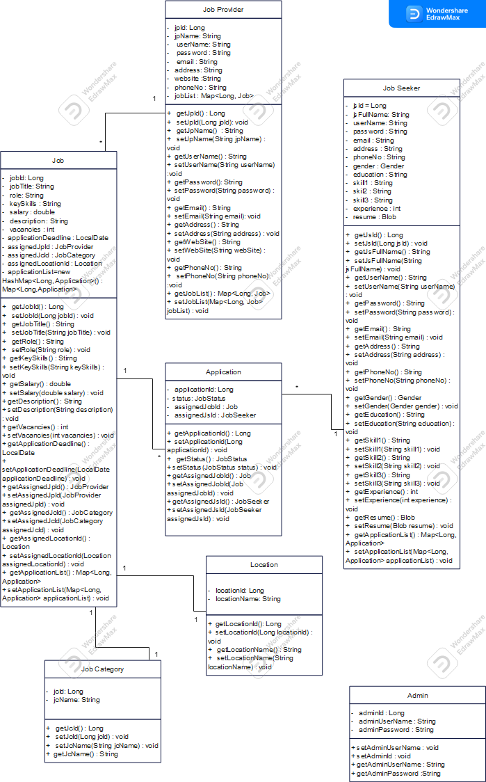
UML Class Diagram

Slide 10
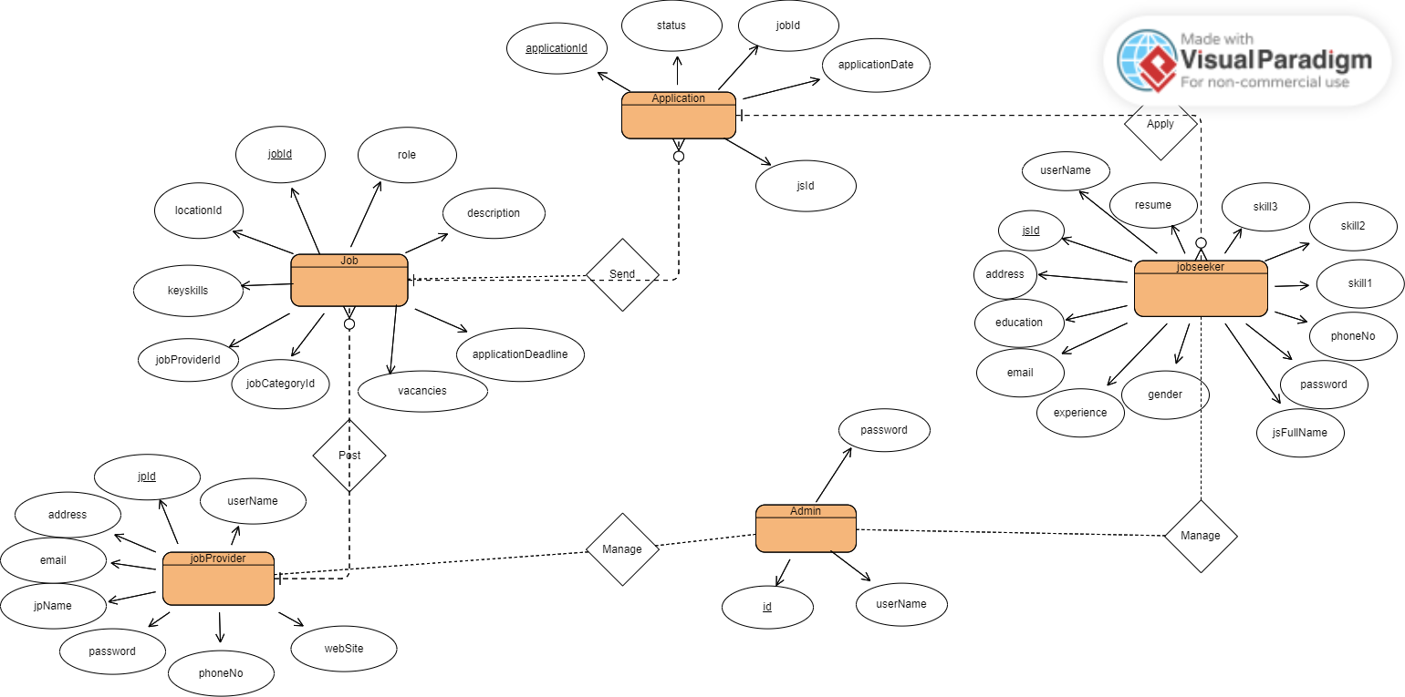
ER Diagram

Slide 11
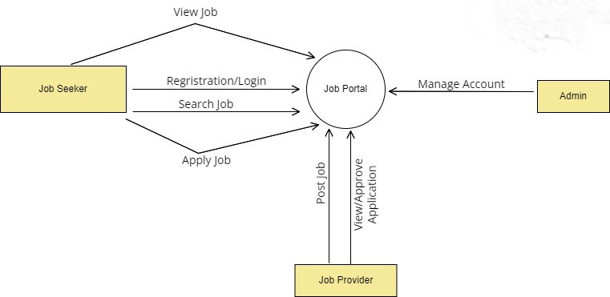
DFD Diagram Level 0

Slide 12
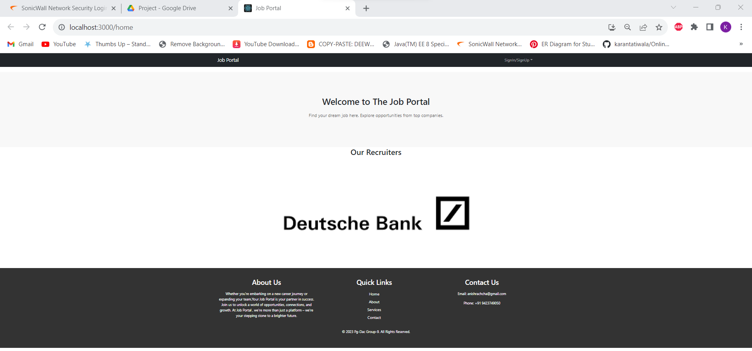
Home Page

Slide 13
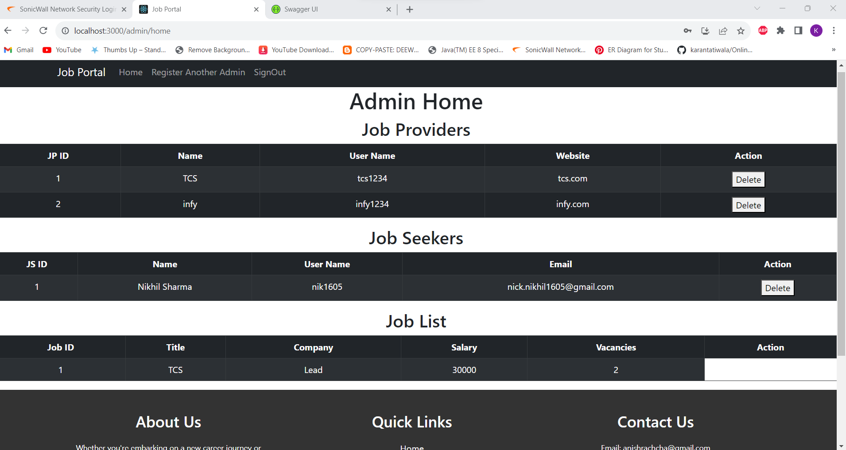
Admin Home Page

Slide 14
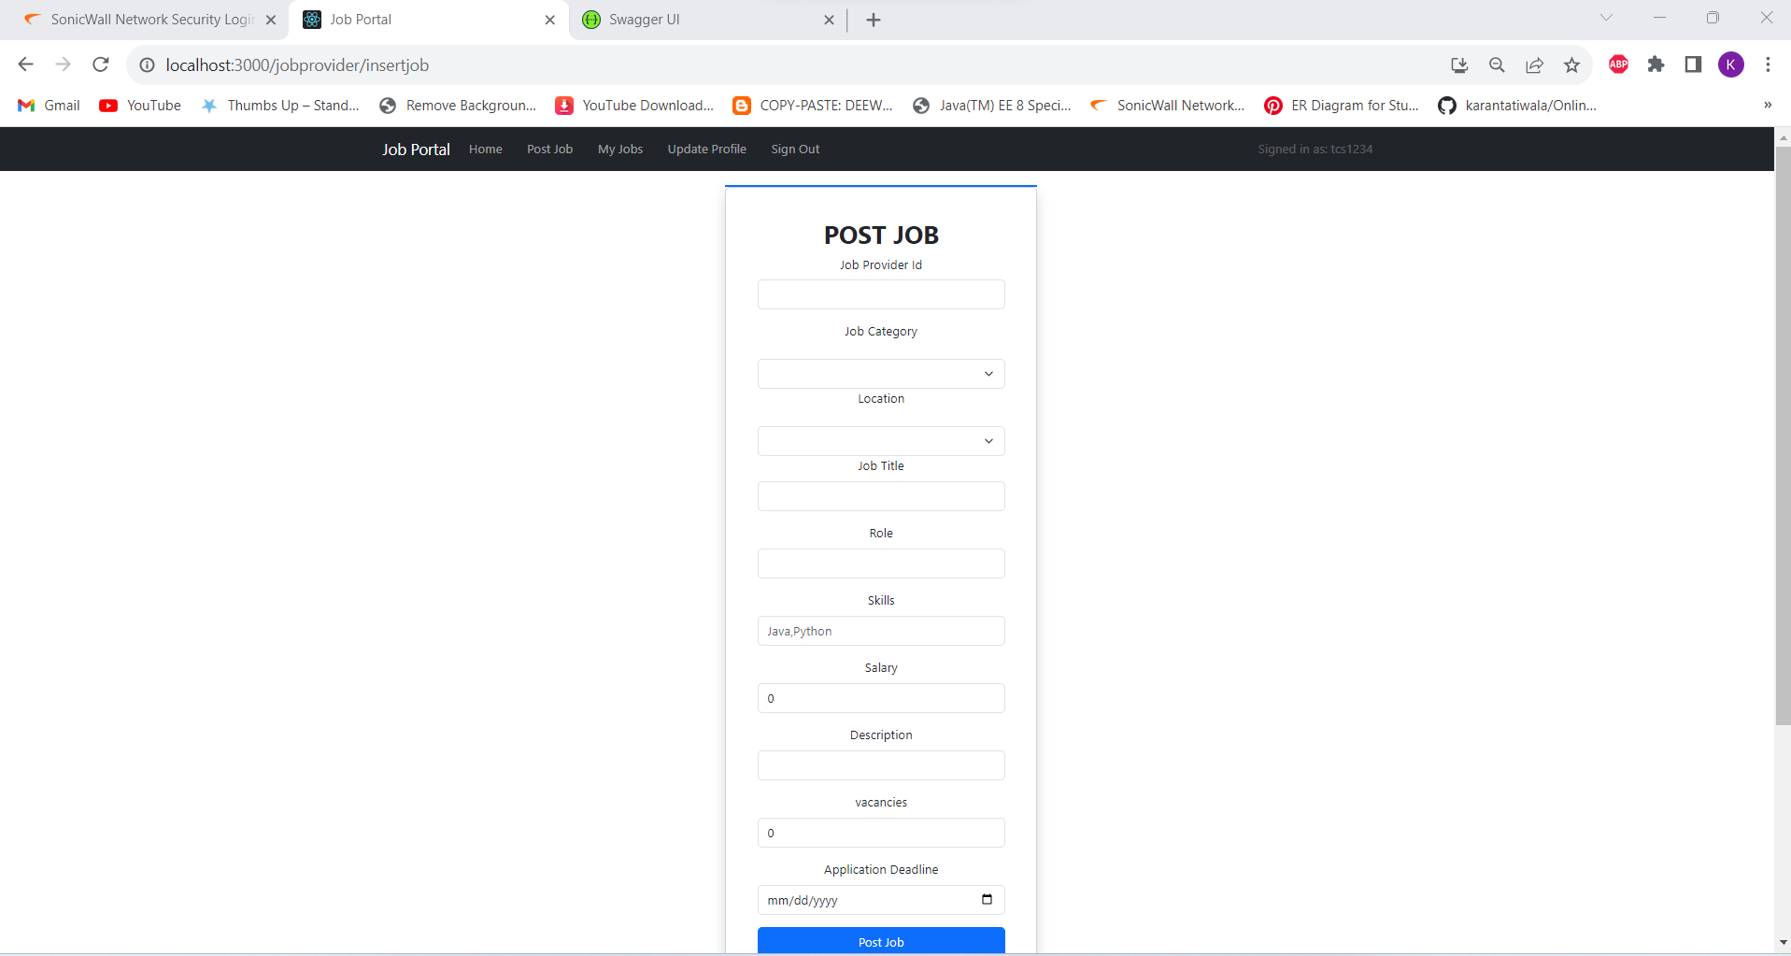
Job Provider Post Job Page

Slide 15
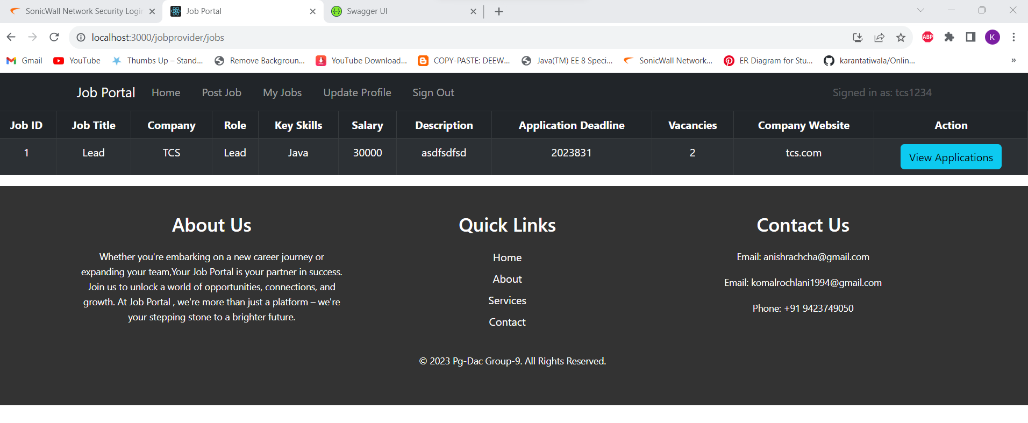
Job Posted List

Slide 16
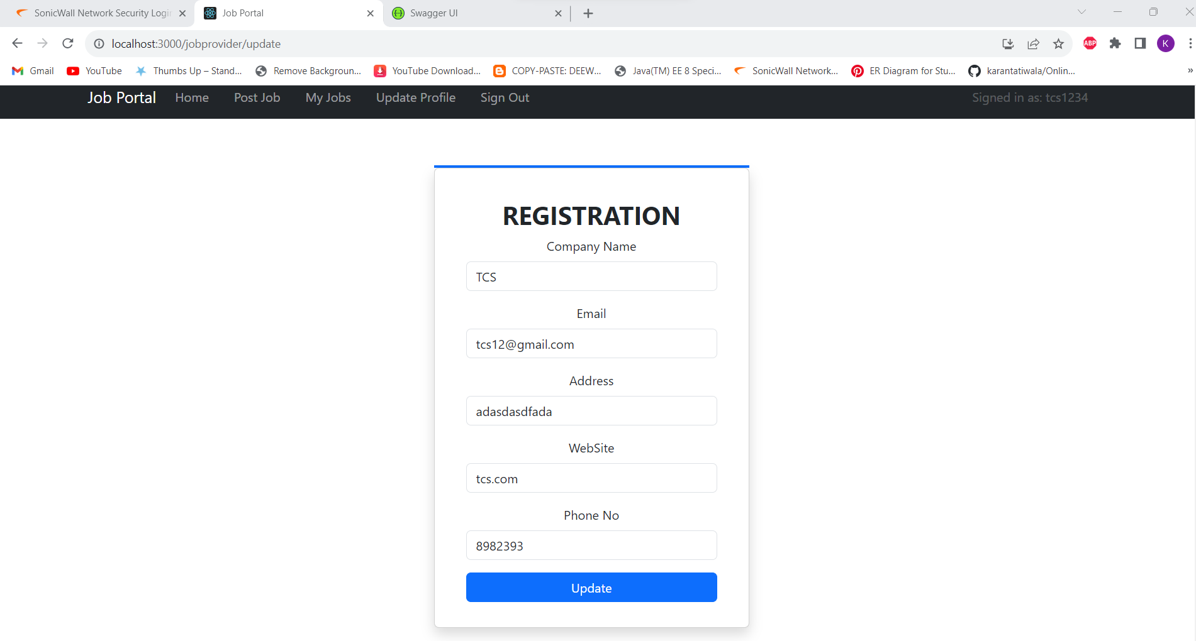
Job Provider Registration

Slide 17
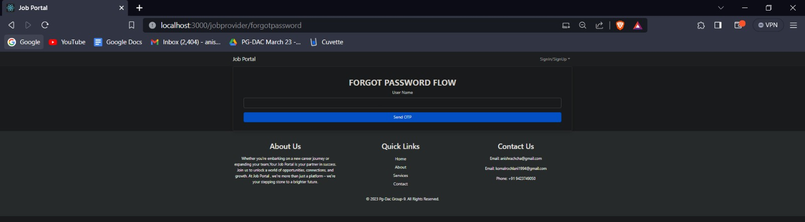
Forget Password Page

Slide 18
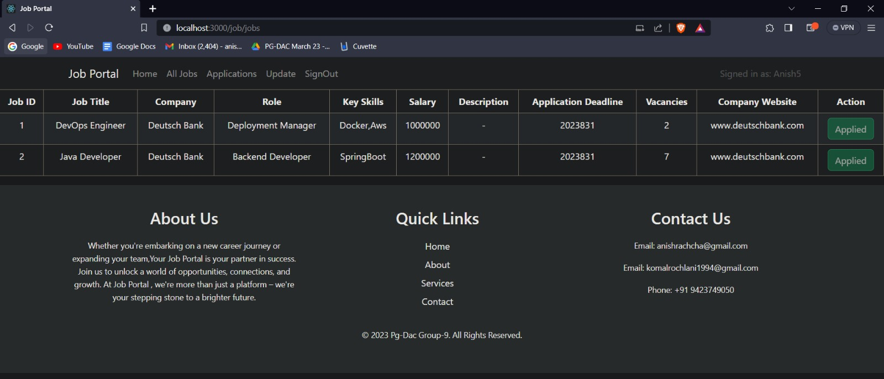
Job Seeker Job List Page

Slide 19
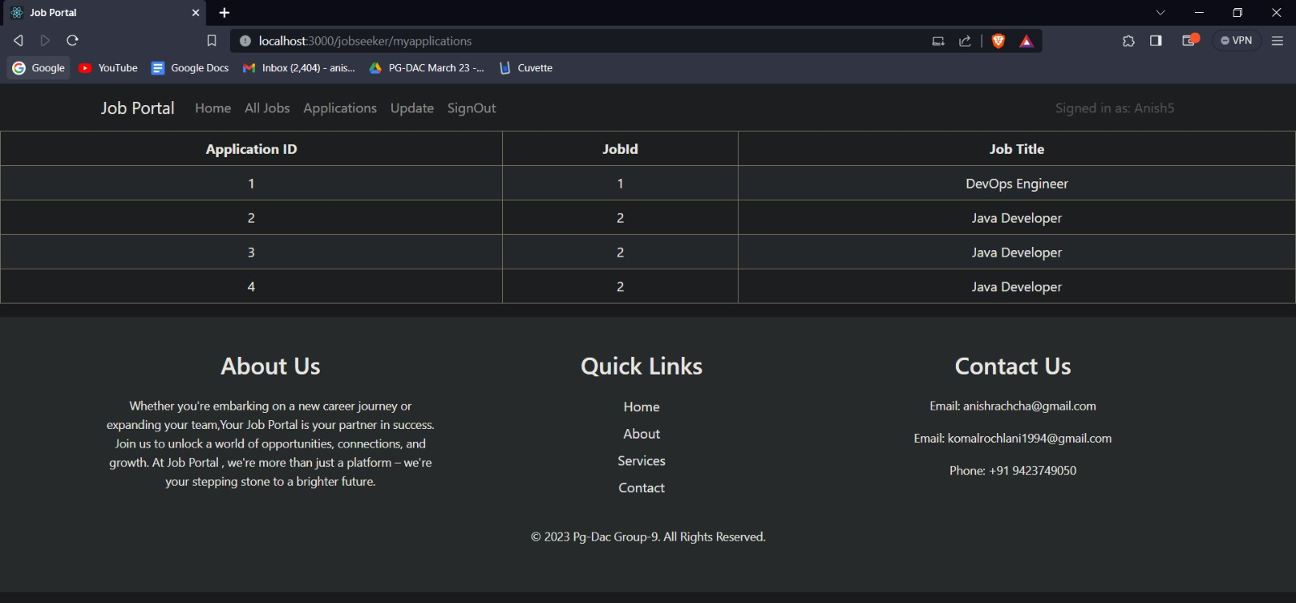
Job Seeker Applied List

Slide 20
Conclusion
This will provide better opportunities and guidance in future in developing projects independently.

